Slide 1
ME 141
Engineering Mechanics
Portion 1
Introduction to Mechanics
Partha Kumar Das
Lecturer
Department of Mechanical Engineering, BUET
http://parthakdas.buet.ac.bd

Slide 2
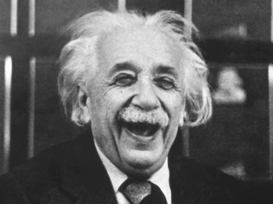
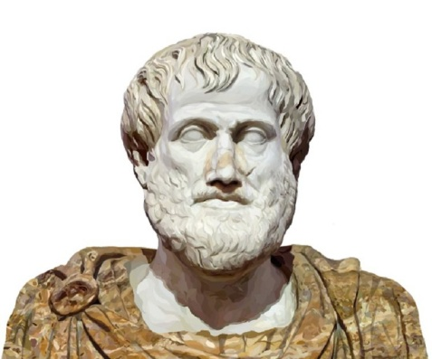
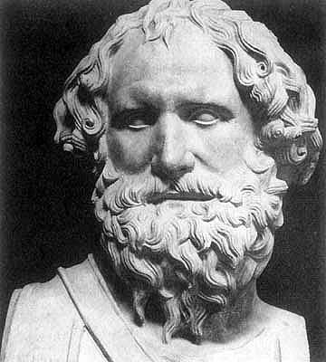
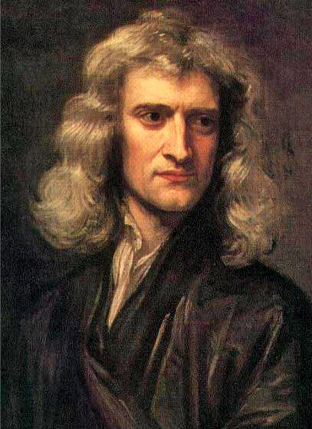
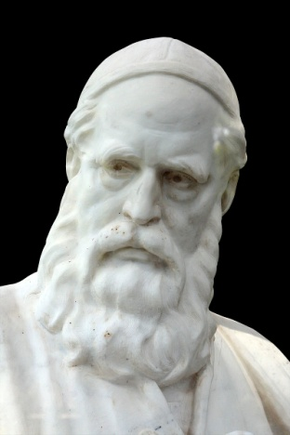
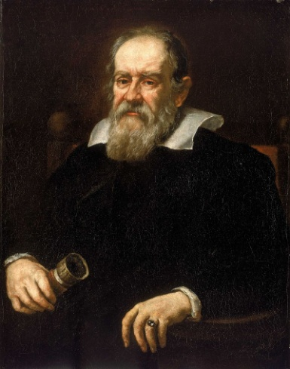
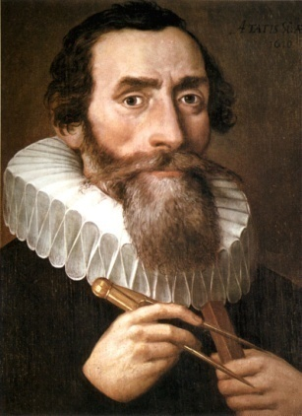
Mechanics
Foundation of Engineering and Physical Science
Core of Engineering Design
Aristotle
Archimedes
Ommar Khayyam
Johannes Kepler
Galileo Galilei
Sir Isaac Newton

Slide 3
Mechanics
Deals with the condition of motion or rest of a physical body under the action of forces, torques or moments.
Mechanics
Classical Mechanics
Mechanics of Rigid Bodies
Statics
Dynamics
Mechanics of Deformation
Mechanics of Fluids
Quantum Mechanics

Slide 4
Basic Concepts of Classical Mechanics
Space Position of a Point or Body in 2-D or 3-D Absolutely Independent
Time Determination of an Event
Absolutely Independent
Mass Representative of a Body Absolutely Independent
Force Action of One Body with Another Reason of Study of Mechanics of a Body

Slide 5
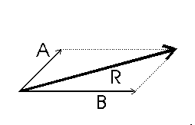
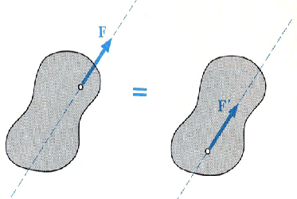
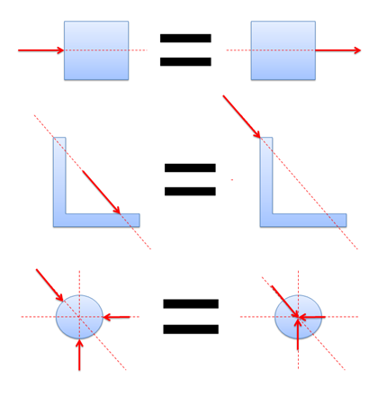
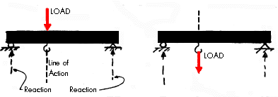
Fundamental Principles of Classical Mechanics
The Parallelogram Law for the Addition of Forces
The Principle of Transmissibility.

Slide 6
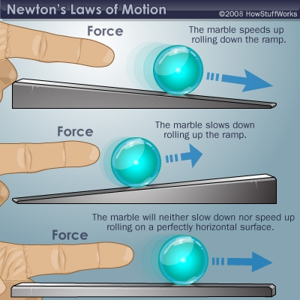
Fundamental Principles of Classical Mechanics
Newton’s Three Fundamental Laws
First Law of Motion 2. Second Law of Motion 3. Third Law of Motion
Newton’s law of Gravitation

Slide 7
Mechanics of Rigid Body
Rigid Body Assumption
Deformation of the body under a force is negligible and has no effect on the condition of equilibrium or motion of the body.
Statics
Based on the Newton’s First Law of Motion
Study the resultant of applied and inherent force and equilibrium of a body at rest.
Dynamics
Based on the Newton’s Second and Third Law of Motion
Study the motion of a body due to applied force.
Incomplete and improper knowledge on Statics and Dynamics may result in a faulty engineering design and cause the destruction of structure or machine.

Slide 8
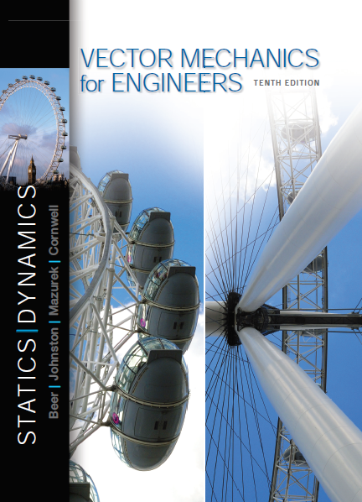
References
Vector Mechanics for Engineers: Statics and Dynamics
Ferdinand Beer, Jr., E. Russell Johnston, David Mazurek, Phillip Cornwell. (Edition is not important)
Engineering Mechanics: Statics and Dynamics R.C. Hibbeler
Engineering Mechanics: Statics and Dynamics
J.L. Meriam and L.G. Kraige.

